Slide 1
Sign Language Translation Assistant
Brent Garey, Paschal Corrigan, Bhargav Singapuri, and Ashley Wu

Slide 2
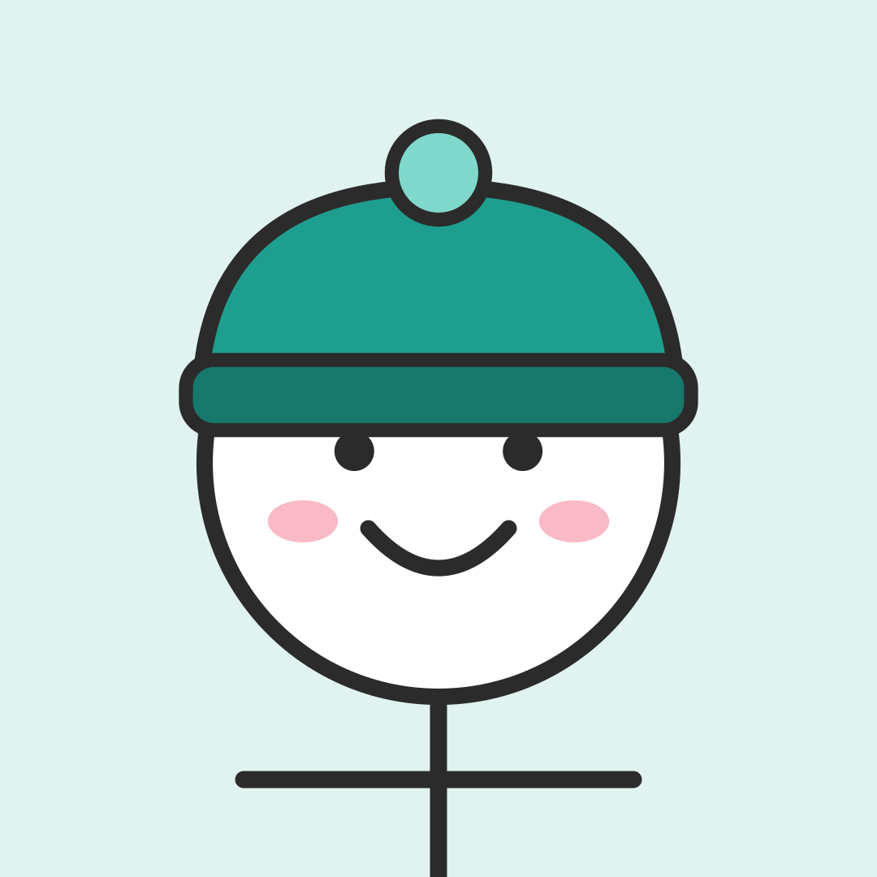
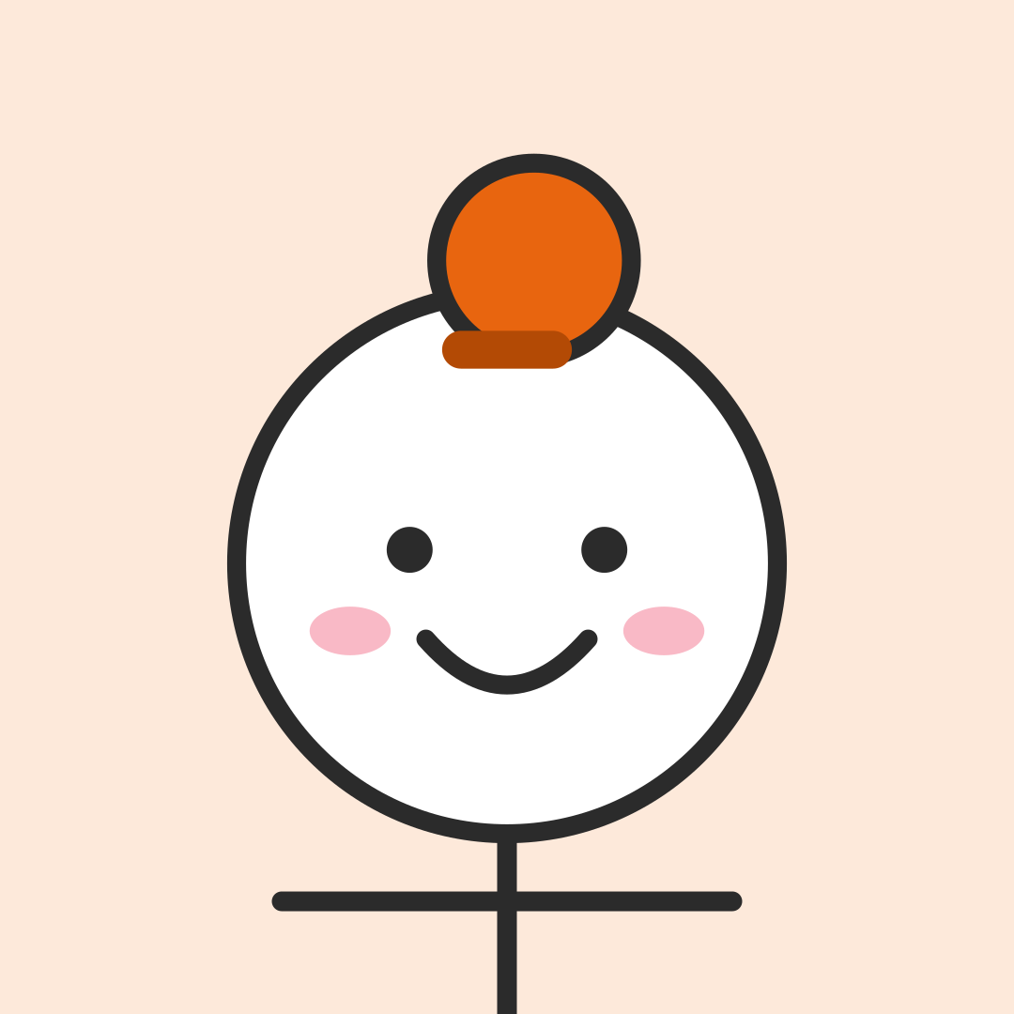
Features and Stakeholders
Path 2: one AI feature, two stakeholders
AI feature: sign-to-English sentence translation. The webcam's pose points (MediaPipe) go to our model, which returns one English sentence with a confidence score from 0 to 100%.
Yang et al.: Level 1. It does not learn during deployment.
Setting: day-to-day conversation, not medical or legal use.
Jordan
Deaf ASL signer using the app. Acts on the output.
Stakeholder map #1
Sam
Non-signing classmate. Reads the caption and is affected by it.
Stakeholder map #2
Notes:
We are on Path 2: one AI feature, the sign-to-English sentence translation. Its confidence score is part of the same output, so it is not a second feature. We follow two stakeholders from our map who meet that output in different ways: Jordan, who signs and acts on it, and Sam, who reads it and is affected by it. Setting is scoped to day-to-day conversation, per our originator meeting. Medical and legal settings are out of scope.

Slide 3
Yang et al.’s four levels
Our AI is level 1:
Does not learn during deployment
  Output does not fluctuate based off of new unseen data
  Opt-in fix requests (Storyboard B1) only feed an offline, team-reviewed retrain
Does not use user data to make translations
  We do not profile the user using facial recognition, user data, or profile data
  User data does not affect translation

Slide 4
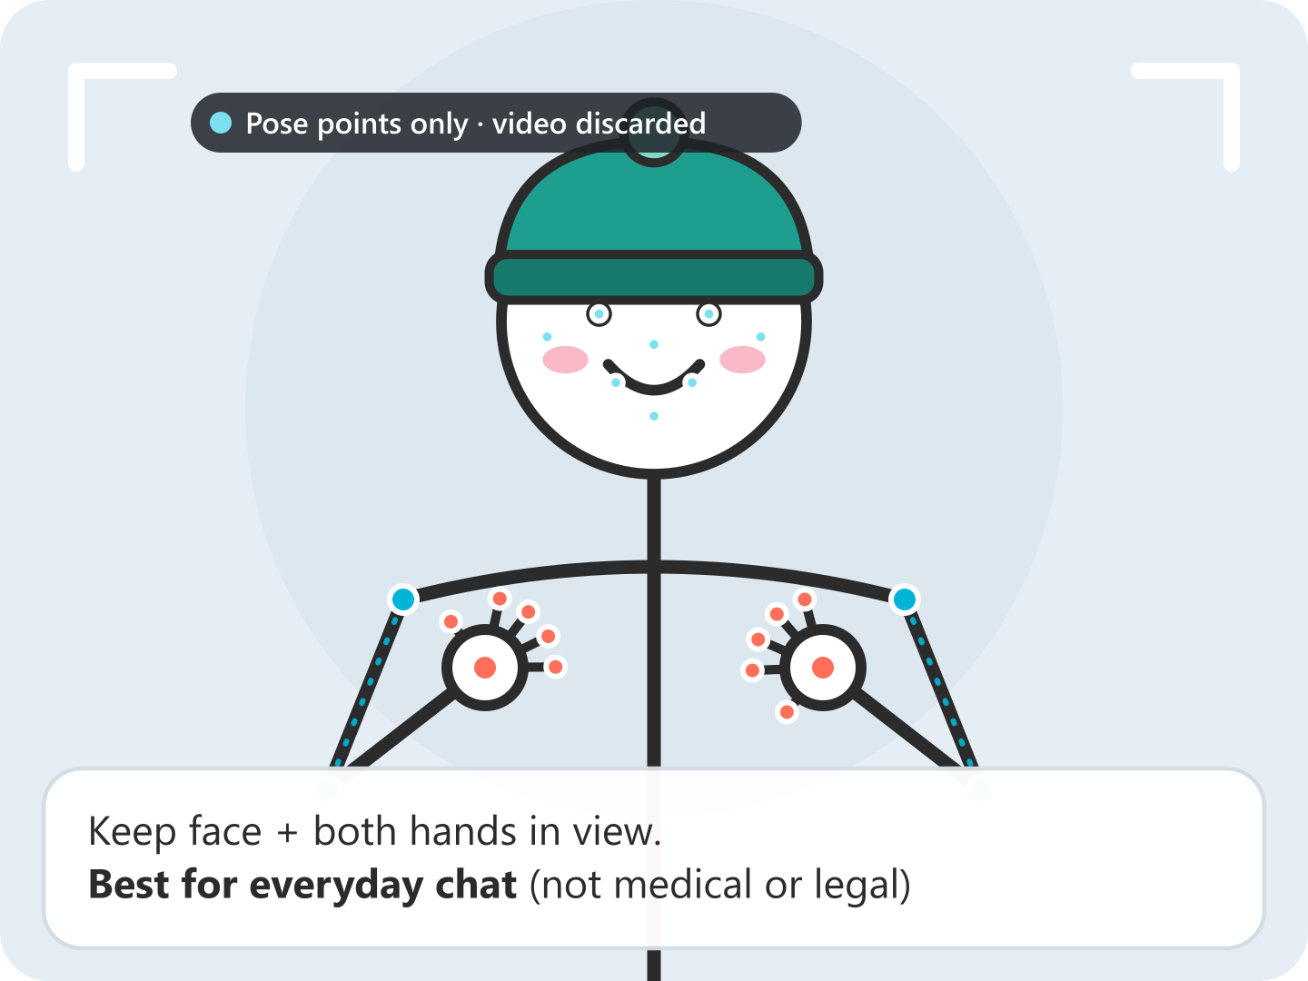
A1 · Translation works: signer's view
Reader: Jordan, a Deaf ASL signer using the app (stakeholder map #1) Setting: Campus café, meeting project partner Sam
1
Panel 1 of 5
Frame face and hands
Jordan props up the phone. The app says what it needs and that it is built for everyday chat.
G1
G1: Show what it can do
Notes:
Panel 1: Jordan props up the phone. The app says what it needs and that it is built for everyday chat. Storyboard A1, reader Jordan. Jordan is Deaf and meeting a new project partner, Sam, at a campus café. Panel 1 (G1): the app is upfront about what it needs (face and both hands) and its scope: everyday chat, not medical or legal. Panels 2 and 3 (G2, G3): like Google Translate, gray words stream in with a live confidence % and may change. Panel 4: when both hands leave the frame, the whole sentence is re-translated at once, here 91%. Panel 5: Jordan acts on the output by checking it and choosing to speak it aloud (G7). Class experiment: show the panels without taglines and ask what the dots on Jordan's body mean.

Slide 5
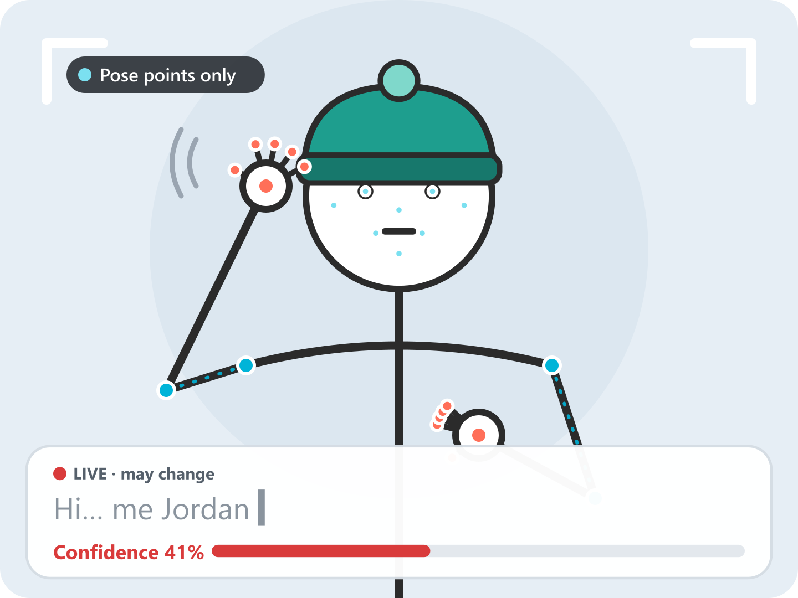
A1 · Translation works: signer's view
Reader: Jordan, a Deaf ASL signer using the app (stakeholder map #1) Setting: Campus café, meeting project partner Sam
2
Panel 2 of 5
Words stream in
As Jordan signs, gray words appear one at a time with a live confidence of 41%. They may still change.
G2
G2: Show how well it does it
Notes:
Panel 2: As Jordan signs, gray words appear one at a time with a live confidence of 41%. They may still change. Storyboard A1, reader Jordan. Jordan is Deaf and meeting a new project partner, Sam, at a campus café. Panel 1 (G1): the app is upfront about what it needs (face and both hands) and its scope: everyday chat, not medical or legal. Panels 2 and 3 (G2, G3): like Google Translate, gray words stream in with a live confidence % and may change. Panel 4: when both hands leave the frame, the whole sentence is re-translated at once, here 91%. Panel 5: Jordan acts on the output by checking it and choosing to speak it aloud (G7). Class experiment: show the panels without taglines and ask what the dots on Jordan's body mean.

Slide 6
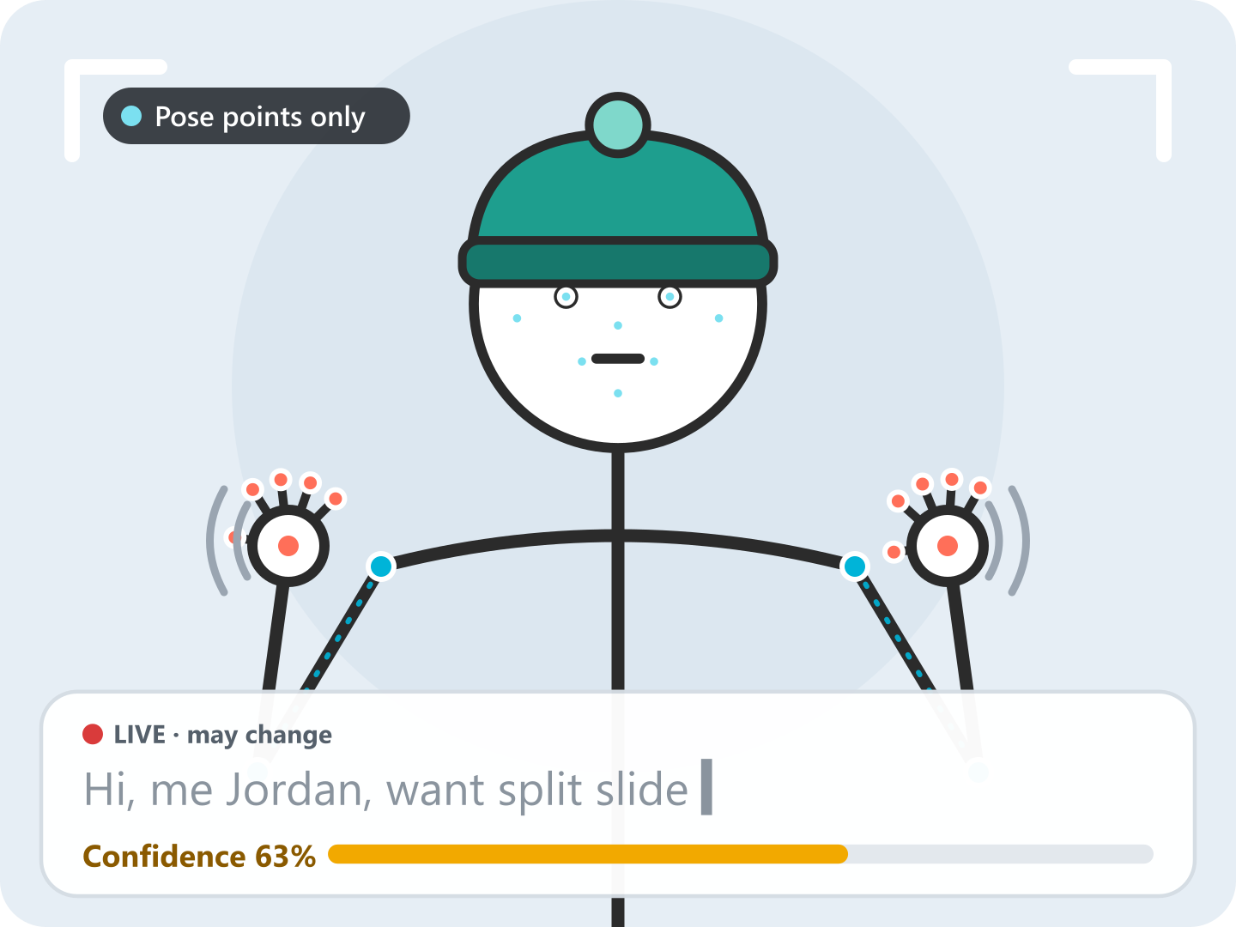
A1 · Translation works: signer's view
Reader: Jordan, a Deaf ASL signer using the app (stakeholder map #1) Setting: Campus café, meeting project partner Sam
3
Panel 3 of 5
The guess keeps updating
More signs arrive and the live guess grows to “Hi, me Jordan, want split slide” at 63%.
G3
G3: Time to the context
Notes:
Panel 3: More signs arrive and the live guess grows to “Hi, me Jordan, want split slide” at 63%. Storyboard A1, reader Jordan. Jordan is Deaf and meeting a new project partner, Sam, at a campus café. Panel 1 (G1): the app is upfront about what it needs (face and both hands) and its scope: everyday chat, not medical or legal. Panels 2 and 3 (G2, G3): like Google Translate, gray words stream in with a live confidence % and may change. Panel 4: when both hands leave the frame, the whole sentence is re-translated at once, here 91%. Panel 5: Jordan acts on the output by checking it and choosing to speak it aloud (G7). Class experiment: show the panels without taglines and ask what the dots on Jordan's body mean.

Slide 7
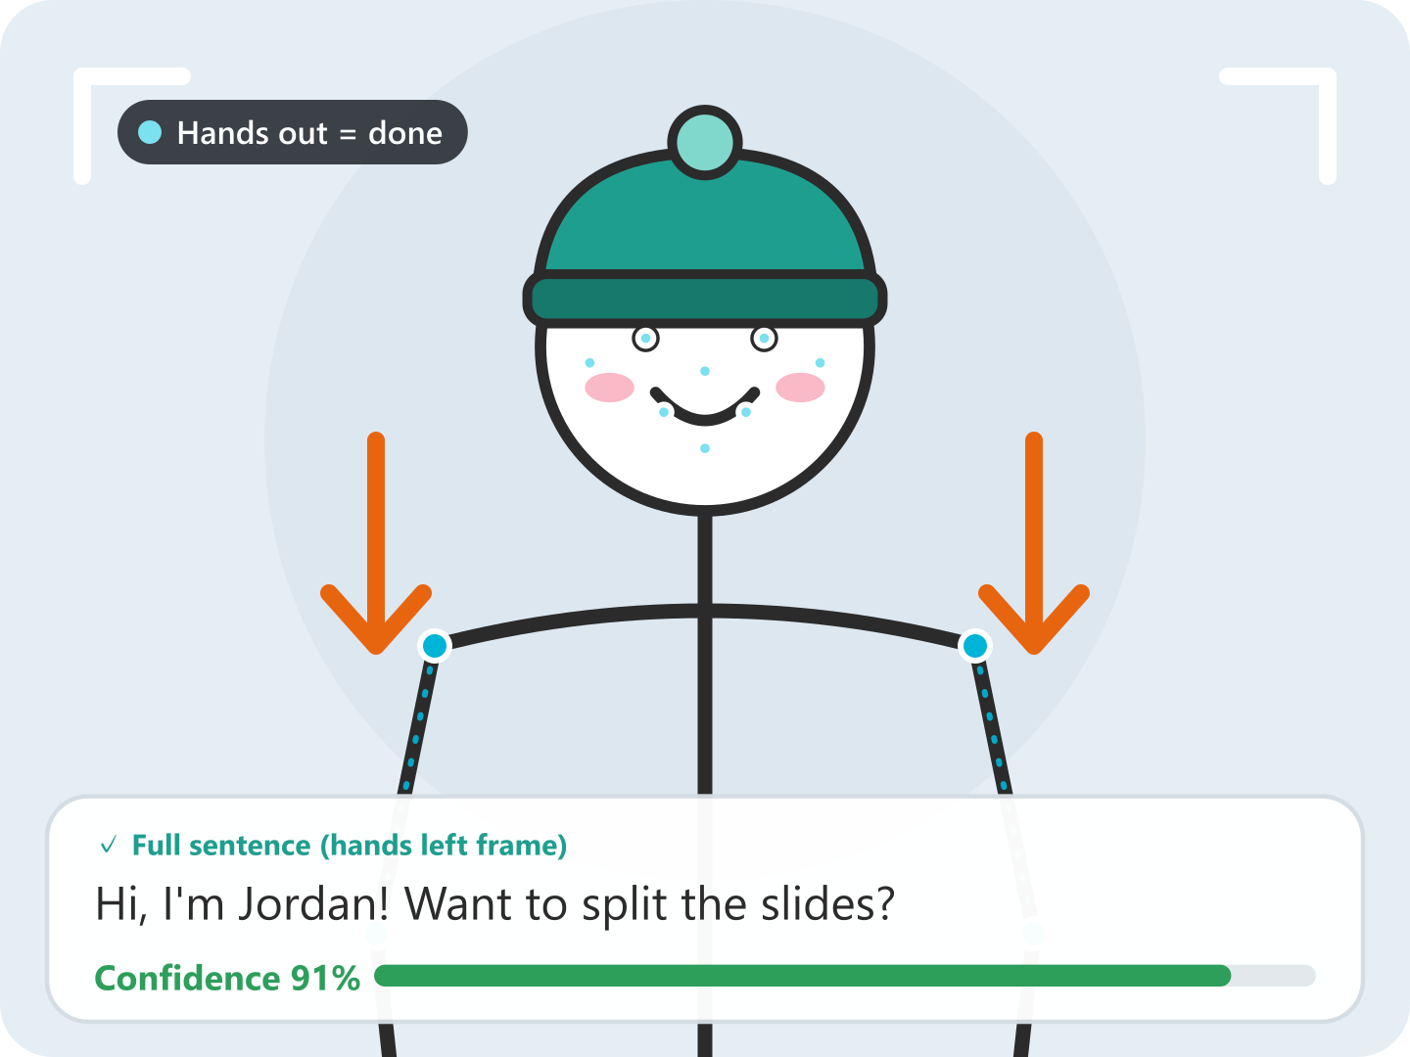
A1 · Translation works: signer's view
Reader: Jordan, a Deaf ASL signer using the app (stakeholder map #1) Setting: Campus café, meeting project partner Sam
4
Panel 4 of 5
Hands out, sentence rewritten
Jordan drops both hands out of frame. The app re-translates the whole sentence into fluent English at 91%.
G2
G2: Show how well it does it
Notes:
Panel 4: Jordan drops both hands out of frame. The app re-translates the whole sentence into fluent English at 91%. Storyboard A1, reader Jordan. Jordan is Deaf and meeting a new project partner, Sam, at a campus café. Panel 1 (G1): the app is upfront about what it needs (face and both hands) and its scope: everyday chat, not medical or legal. Panels 2 and 3 (G2, G3): like Google Translate, gray words stream in with a live confidence % and may change. Panel 4: when both hands leave the frame, the whole sentence is re-translated at once, here 91%. Panel 5: Jordan acts on the output by checking it and choosing to speak it aloud (G7). Class experiment: show the panels without taglines and ask what the dots on Jordan's body mean.

Slide 8
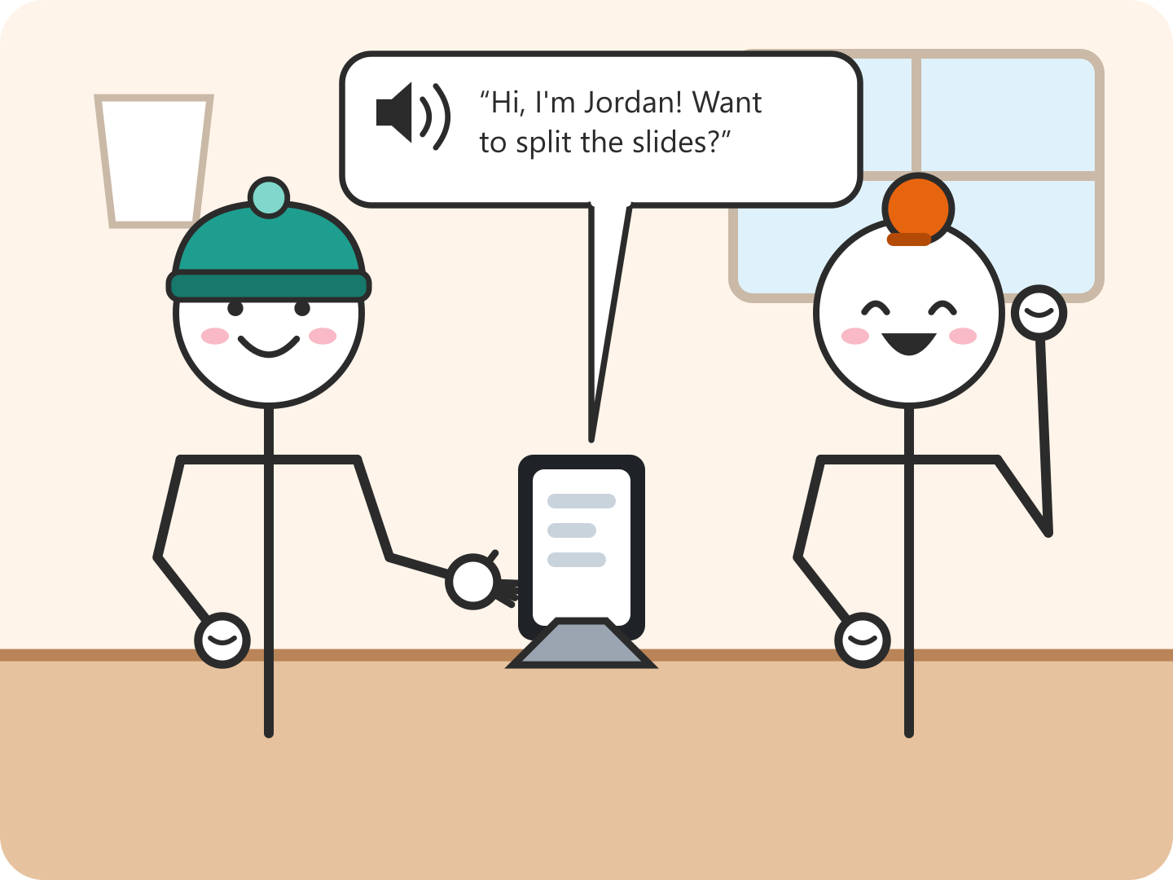
A1 · Translation works: signer's view
Reader: Jordan, a Deaf ASL signer using the app (stakeholder map #1) Setting: Campus café, meeting project partner Sam
5
Panel 5 of 5
Say it aloud
The caption matches, so Jordan taps Speak and Sam hears it.
G7
Acts on output
G7: Efficient invocation
Why it works Why the model gets this right: short, everyday sentences signed front-on with face and both hands in view, close to the instructional, front-facing How2Sign recordings it was trained on.
Notes:
Panel 5: The caption matches, so Jordan taps Speak and Sam hears it. Storyboard A1, reader Jordan. Jordan is Deaf and meeting a new project partner, Sam, at a campus café. Panel 1 (G1): the app is upfront about what it needs (face and both hands) and its scope: everyday chat, not medical or legal. Panels 2 and 3 (G2, G3): like Google Translate, gray words stream in with a live confidence % and may change. Panel 4: when both hands leave the frame, the whole sentence is re-translated at once, here 91%. Panel 5: Jordan acts on the output by checking it and choosing to speak it aloud (G7). Class experiment: show the panels without taglines and ask what the dots on Jordan's body mean.

Slide 9
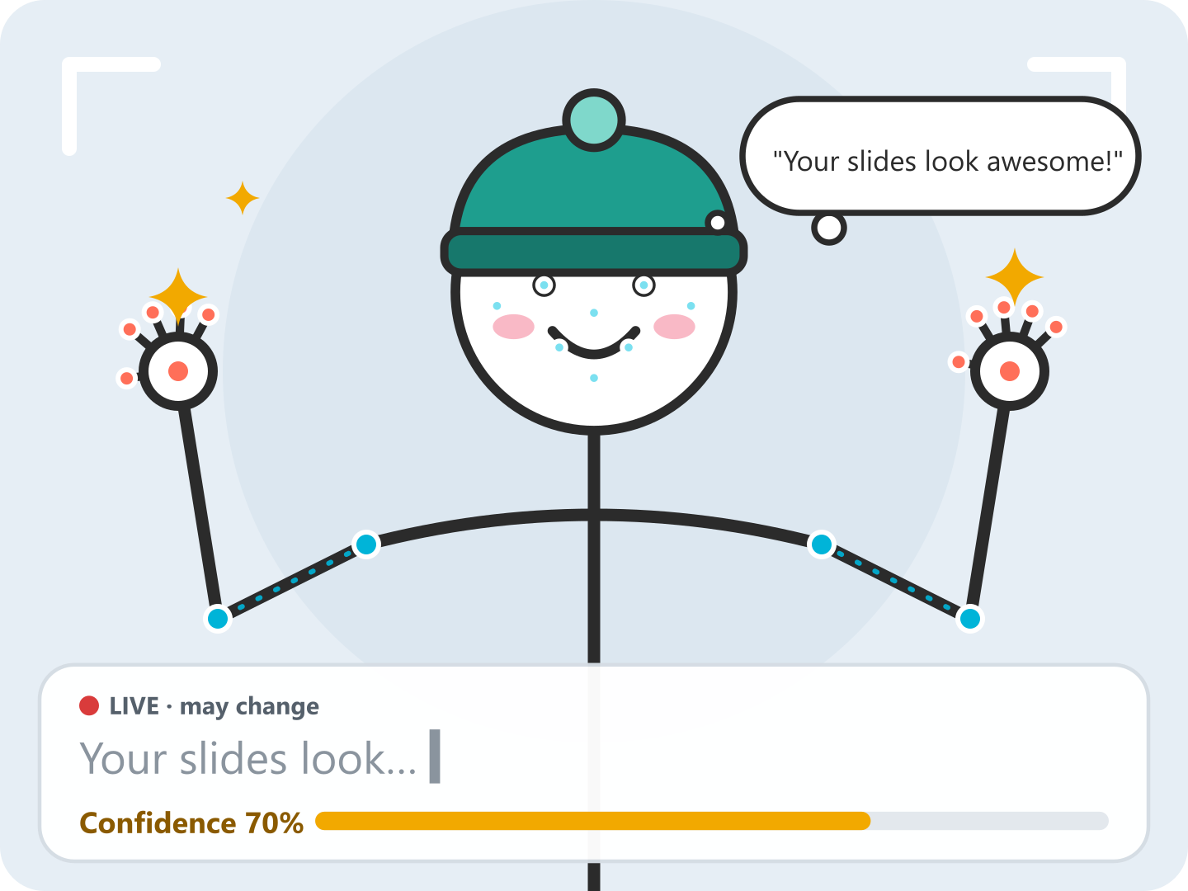
B1 · Mistranslation: signer's view
Reader: Jordan, a Deaf ASL signer using the app (stakeholder map #1) Setting: Same café, a few minutes later
1
Panel 1 of 5
Use a casual sign
Jordan signs “Your slides look awesome!” with a casual sign. The live guess reads “Your slides look…” at 70%.
Notes:
Panel 1: Jordan signs “Your slides look awesome!” with a casual sign. The live guess reads “Your slides look…” at 70%. Storyboard B1, reader Jordan. The same casual sign the model never saw in How2Sign comes out as a swear. Stage 5 (panel 2): the system shows doubt. It flags the caption as Unsure, underlines the sign and does not read it aloud (G10, G11). Jordan acts on the output in panel 3 by re-signing the sentence. Dropping both hands out of frame marks the sentence end, and the new translation replaces the flagged one (G8). Stage 4 recovery (panel 4): after two unsure tries, typing is offered (G9). Panel 5: saving the failed phrase is opt-in, keeps no video, and only feeds an offline, reviewed retrain. The live model does not change, so we stay at Yang Level 1.

Slide 10
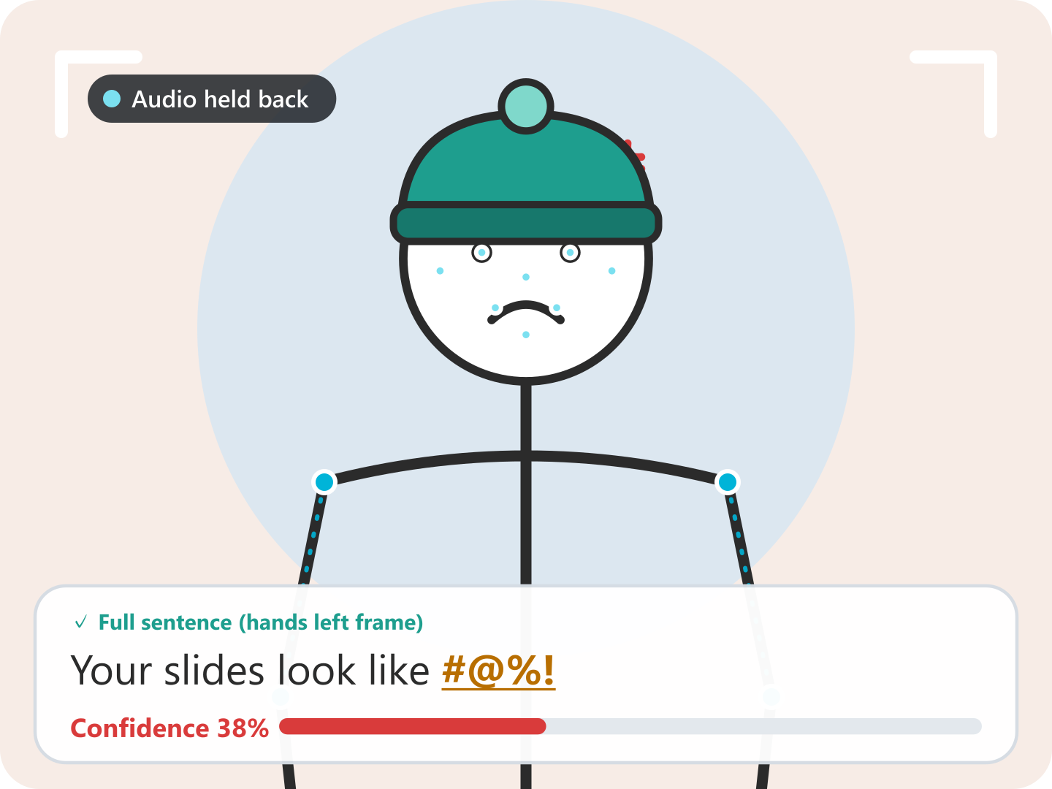
B1 · Mistranslation: signer's view
Reader: Jordan, a Deaf ASL signer using the app (stakeholder map #1) Setting: Same café, a few minutes later
2
Panel 2 of 5
Hands out: 38% swear
When Jordan's hands leave the frame, the full sentence comes out as a swear at 38%. The unknown sign is underlined and audio is held back.
S5 / G10
S5 / G11
G10: Scope when in doubt
G11: Explain why
Datasheet gap How2Sign, our training set, is ~80 h of instructional ASL from 11 signers, filmed front-on in a studio. Casual and regional sign variants are rare, so an out-of-vocabulary (OOV) sign is mapped to the closest sign the model knows. Webcam conditions also differ from the studio (stakeholder map #1).
Notes:
Panel 2: When Jordan's hands leave the frame, the full sentence comes out as a swear at 38%. The unknown sign is underlined and audio is held back. Storyboard B1, reader Jordan. The same casual sign the model never saw in How2Sign comes out as a swear. Stage 5 (panel 2): the system shows doubt. It flags the caption as Unsure, underlines the sign and does not read it aloud (G10, G11). Jordan acts on the output in panel 3 by re-signing the sentence. Dropping both hands out of frame marks the sentence end, and the new translation replaces the flagged one (G8). Stage 4 recovery (panel 4): after two unsure tries, typing is offered (G9). Panel 5: saving the failed phrase is opt-in, keeps no video, and only feeds an offline, reviewed retrain. The live model does not change, so we stay at Yang Level 1.

Slide 11
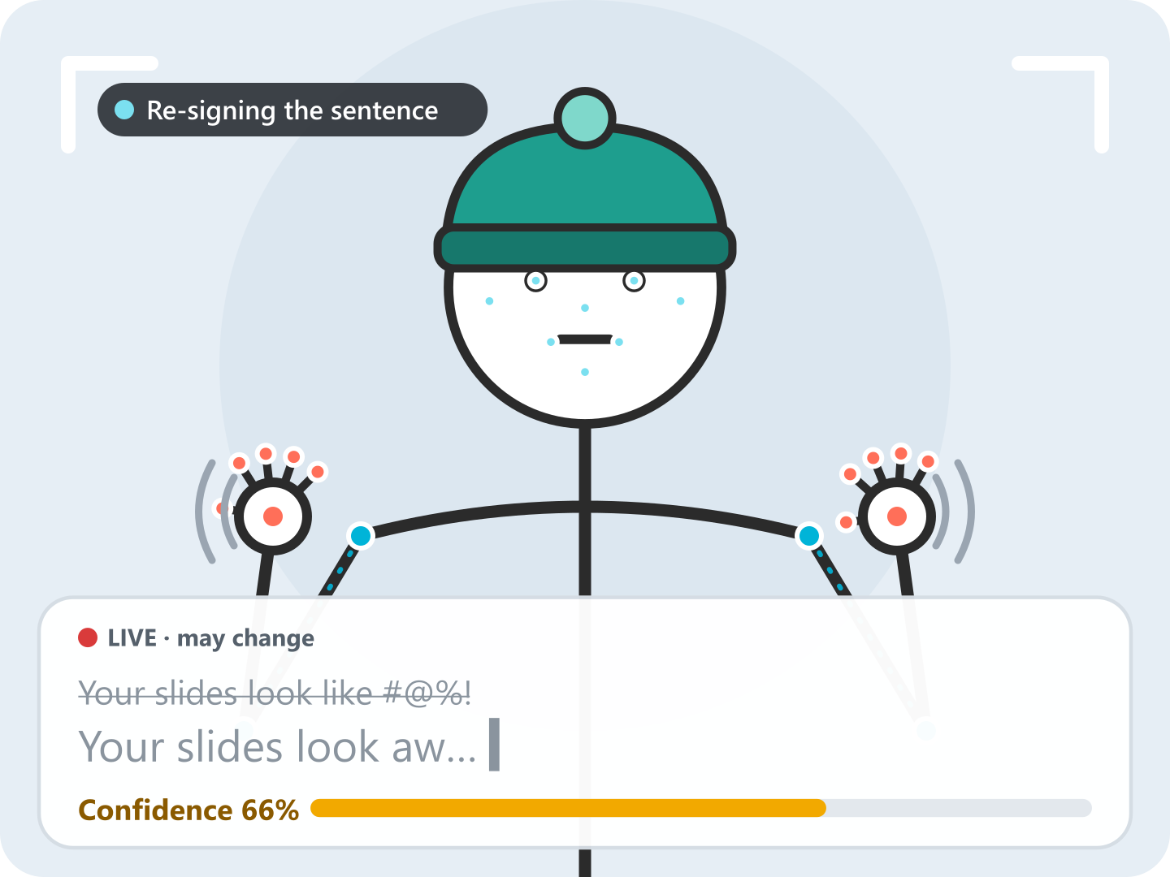
B1 · Mistranslation: signer's view
Reader: Jordan, a Deaf ASL signer using the app (stakeholder map #1) Setting: Same café, a few minutes later
3
Panel 3 of 5
Re-sign the sentence
Jordan signs it again. The bad caption is struck out and a new live guess builds word by word (66%).
S4 / G8
Acts on output
G8: Efficient dismissal
Notes:
Panel 3: Jordan signs it again. The bad caption is struck out and a new live guess builds word by word (66%). Storyboard B1, reader Jordan. The same casual sign the model never saw in How2Sign comes out as a swear. Stage 5 (panel 2): the system shows doubt. It flags the caption as Unsure, underlines the sign and does not read it aloud (G10, G11). Jordan acts on the output in panel 3 by re-signing the sentence. Dropping both hands out of frame marks the sentence end, and the new translation replaces the flagged one (G8). Stage 4 recovery (panel 4): after two unsure tries, typing is offered (G9). Panel 5: saving the failed phrase is opt-in, keeps no video, and only feeds an offline, reviewed retrain. The live model does not change, so we stay at Yang Level 1.

Slide 12
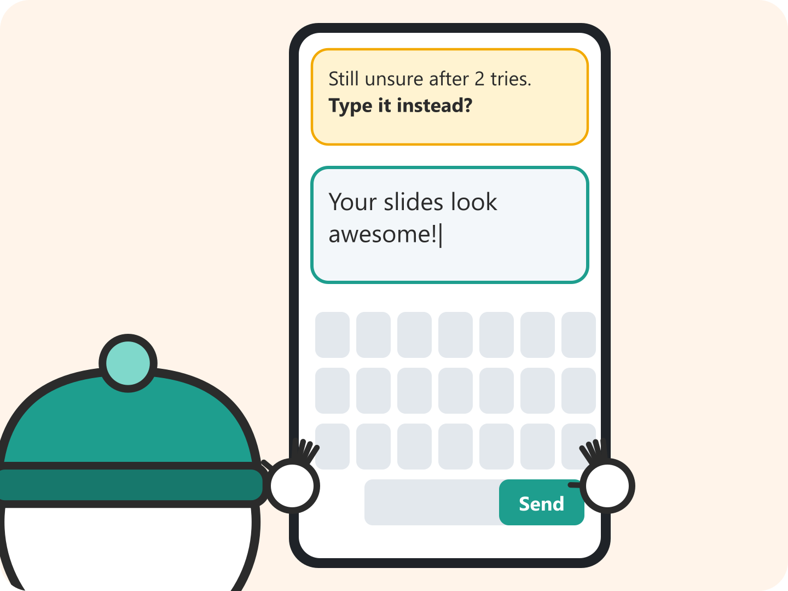
B1 · Mistranslation: signer's view
Reader: Jordan, a Deaf ASL signer using the app (stakeholder map #1) Setting: Same café, a few minutes later
4
Panel 4 of 5
Type it instead
After a second unsure try, the app offers the keyboard and Jordan types the sentence.
S4 / G9
G9: Efficient correction
Notes:
Panel 4: After a second unsure try, the app offers the keyboard and Jordan types the sentence. Storyboard B1, reader Jordan. The same casual sign the model never saw in How2Sign comes out as a swear. Stage 5 (panel 2): the system shows doubt. It flags the caption as Unsure, underlines the sign and does not read it aloud (G10, G11). Jordan acts on the output in panel 3 by re-signing the sentence. Dropping both hands out of frame marks the sentence end, and the new translation replaces the flagged one (G8). Stage 4 recovery (panel 4): after two unsure tries, typing is offered (G9). Panel 5: saving the failed phrase is opt-in, keeps no video, and only feeds an offline, reviewed retrain. The live model does not change, so we stay at Yang Level 1.

Slide 13
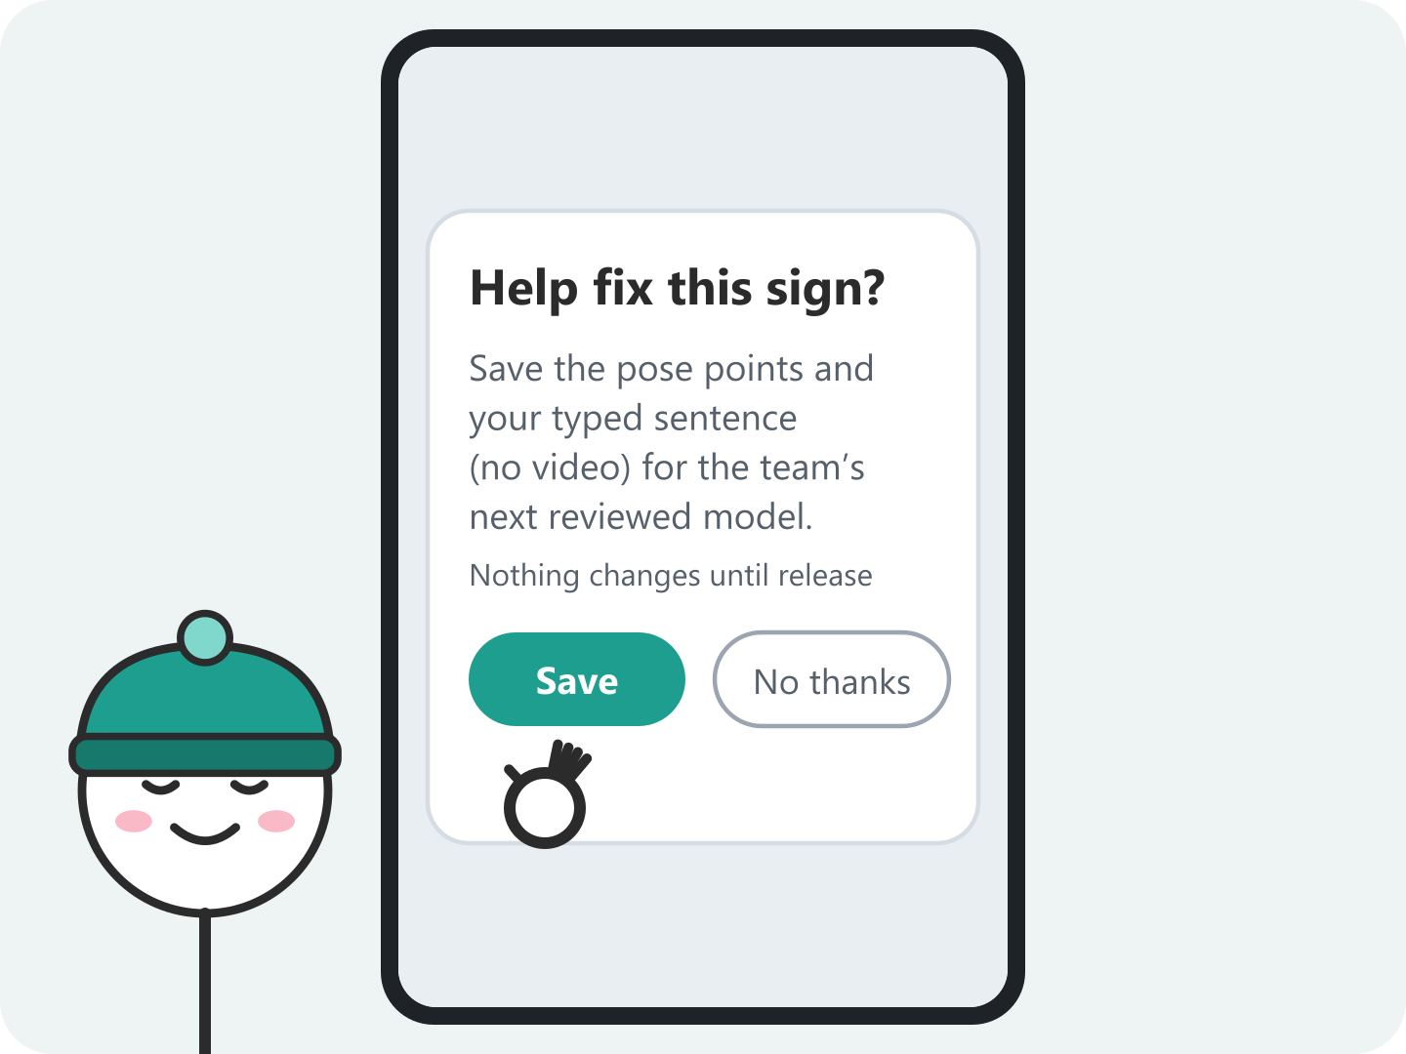
B1 · Mistranslation: signer's view
Reader: Jordan, a Deaf ASL signer using the app (stakeholder map #1) Setting: Same café, a few minutes later
5
Panel 5 of 5
Choose to help
Jordan can opt in to save the pose points and typed text (no video) for the team's next reviewed model.
G15
G15: Granular feedback
Notes:
Panel 5: Jordan can opt in to save the pose points and typed text (no video) for the team's next reviewed model. Storyboard B1, reader Jordan. The same casual sign the model never saw in How2Sign comes out as a swear. Stage 5 (panel 2): the system shows doubt. It flags the caption as Unsure, underlines the sign and does not read it aloud (G10, G11). Jordan acts on the output in panel 3 by re-signing the sentence. Dropping both hands out of frame marks the sentence end, and the new translation replaces the flagged one (G8). Stage 4 recovery (panel 4): after two unsure tries, typing is offered (G9). Panel 5: saving the failed phrase is opt-in, keeps no video, and only feeds an offline, reviewed retrain. The live model does not change, so we stay at Yang Level 1.

Slide 14
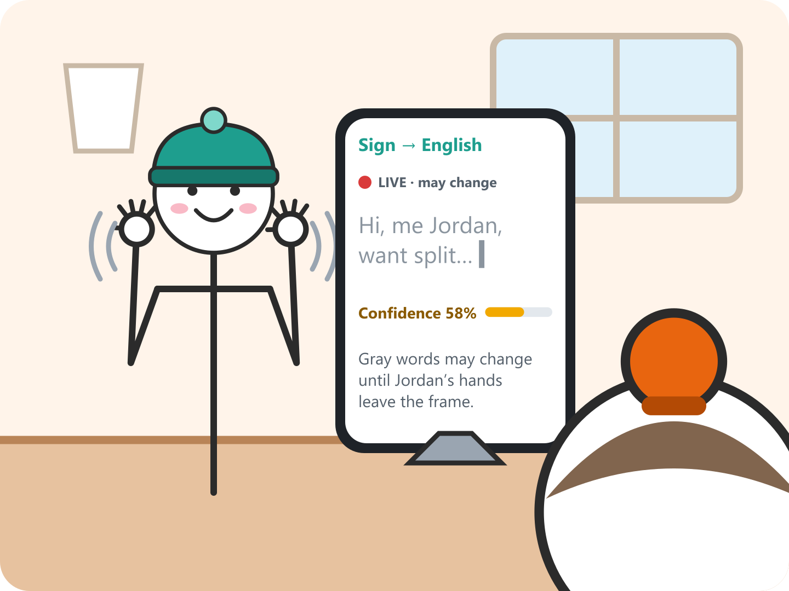
A2 · Translation works: reader's view
Reader: Sam, a non-signing classmate who reads the captions (stakeholder map #2) Setting: Campus café, meeting project partner Jordan
1
Panel 1 of 4
Watch words stream in
Sam sees gray words arrive with a live 58% and a note that they may change until Jordan's hands leave the frame.
G1
G1: Show what it can do
Notes:
Panel 1: Sam sees gray words arrive with a live 58% and a note that they may change until Jordan's hands leave the frame. Storyboard A2, reader Sam. Same conversation as A1, seen by the person who cannot sign. Sam needs to know when to wait (G1) and how much to trust what appears (G2). Sam acts on the output in panel 3 by answering the question. Point out that Sam's need differs from Jordan's: Sam never controls the translation and only decides whether to believe it.

Slide 15
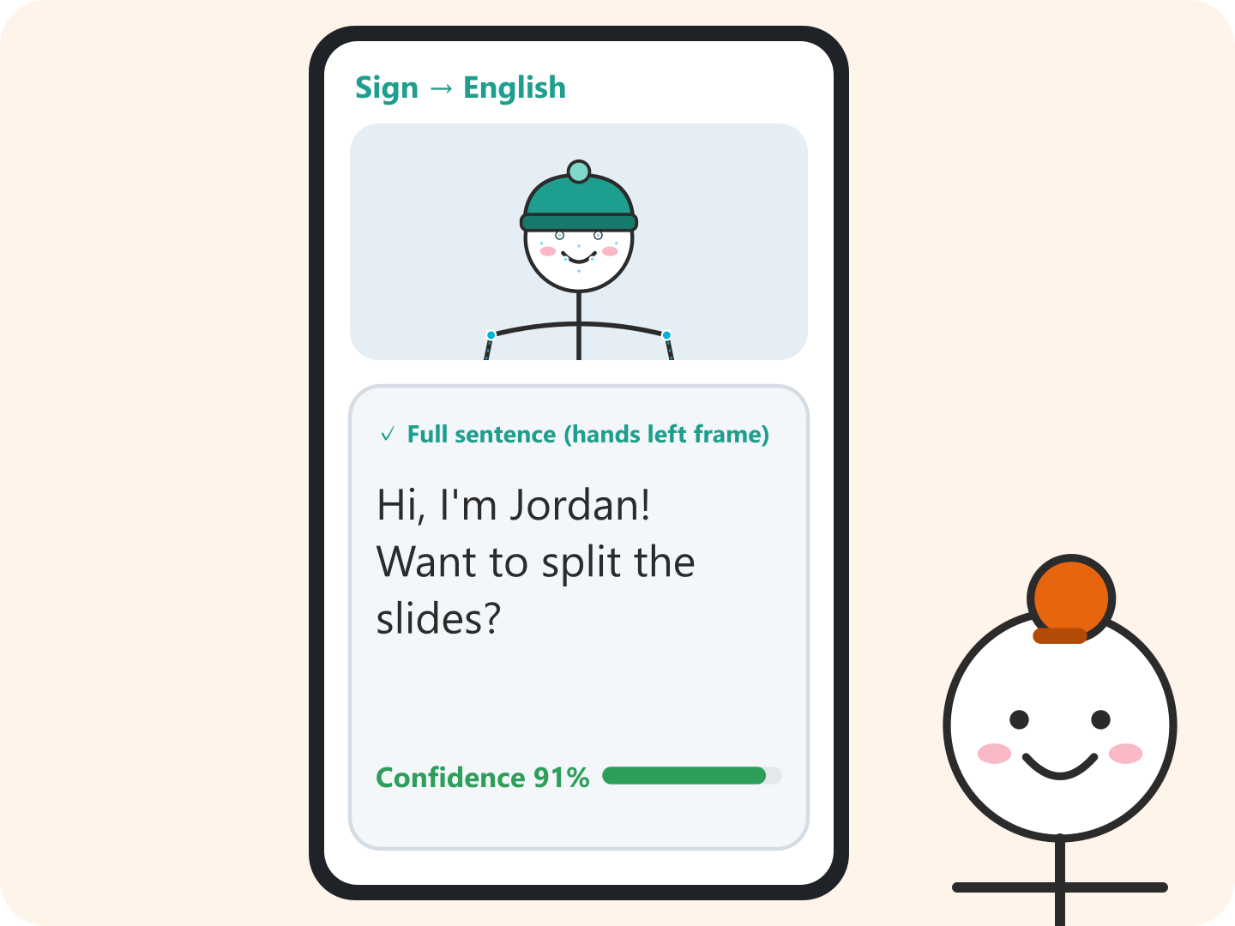
A2 · Translation works: reader's view
Reader: Sam, a non-signing classmate who reads the captions (stakeholder map #2) Setting: Campus café, meeting project partner Jordan
2
Panel 2 of 4
Read the full sentence
When Jordan's hands leave the frame, “Hi, I'm Jordan! Want to split the slides?” appears at 91% confidence.
G2
G2: Show how well it does it
Notes:
Panel 2: When Jordan's hands leave the frame, “Hi, I'm Jordan! Want to split the slides?” appears at 91% confidence. Storyboard A2, reader Sam. Same conversation as A1, seen by the person who cannot sign. Sam needs to know when to wait (G1) and how much to trust what appears (G2). Sam acts on the output in panel 3 by answering the question. Point out that Sam's need differs from Jordan's: Sam never controls the translation and only decides whether to believe it.

Slide 16
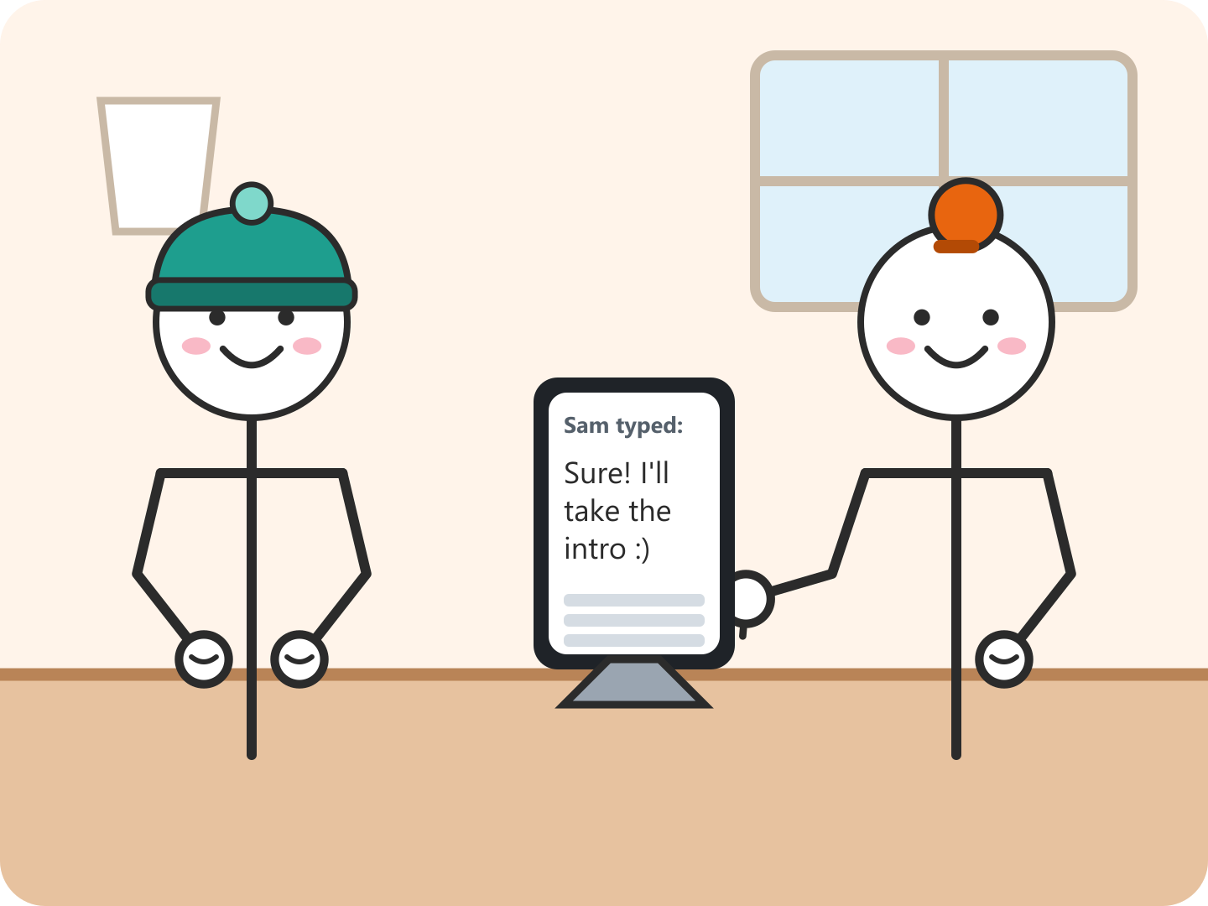
A2 · Translation works: reader's view
Reader: Sam, a non-signing classmate who reads the captions (stakeholder map #2) Setting: Campus café, meeting project partner Jordan
3
Panel 3 of 4
Answer it
Sam trusts the caption and types back “Sure! I'll take the intro.”
Acts on output
Notes:
Panel 3: Sam trusts the caption and types back “Sure! I'll take the intro.” Storyboard A2, reader Sam. Same conversation as A1, seen by the person who cannot sign. Sam needs to know when to wait (G1) and how much to trust what appears (G2). Sam acts on the output in panel 3 by answering the question. Point out that Sam's need differs from Jordan's: Sam never controls the translation and only decides whether to believe it.

Slide 17
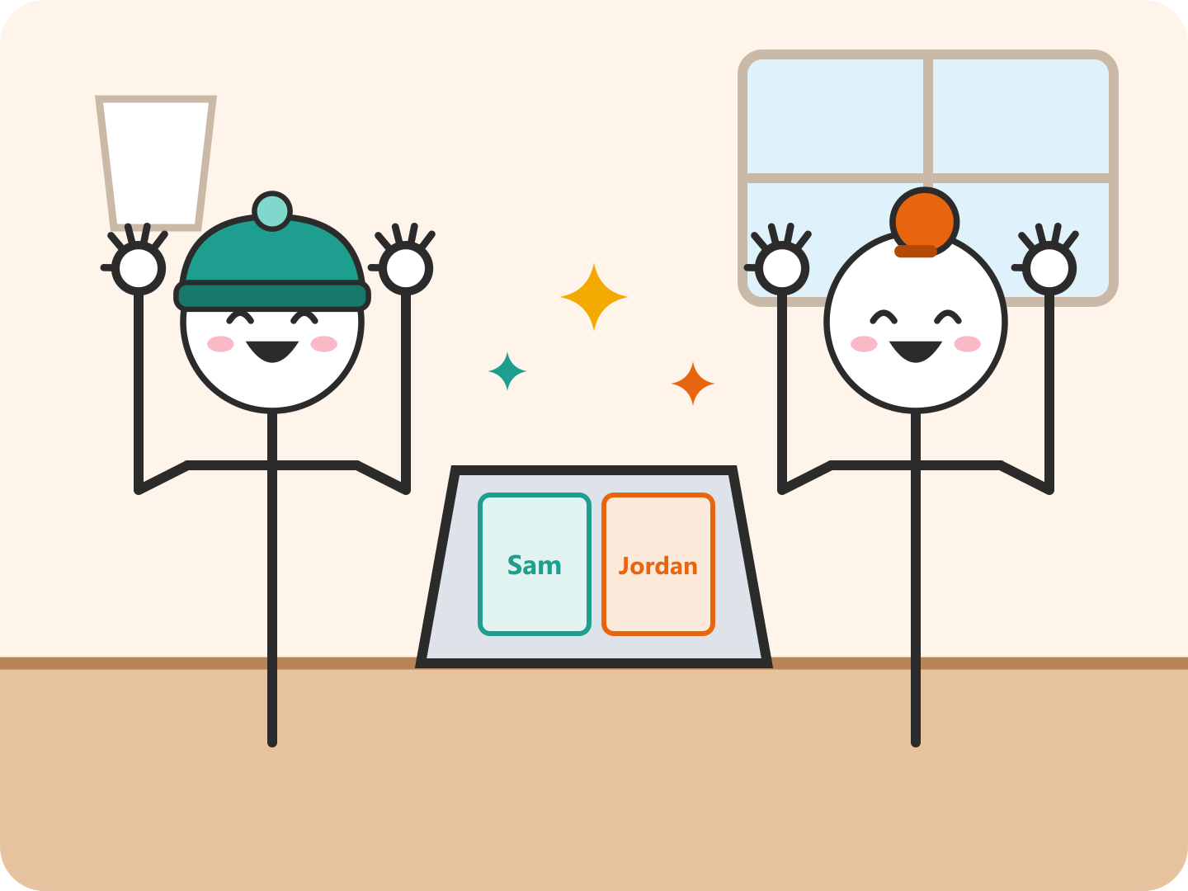
A2 · Translation works: reader's view
Reader: Sam, a non-signing classmate who reads the captions (stakeholder map #2) Setting: Campus café, meeting project partner Jordan
4
Panel 4 of 4
Get to work
They split the slides with no interpreter and no notes passed back and forth.
Why it works Why the model gets this right: short, everyday sentences signed front-on with face and both hands in view, close to the instructional, front-facing How2Sign recordings it was trained on.
Notes:
Panel 4: They split the slides with no interpreter and no notes passed back and forth. Storyboard A2, reader Sam. Same conversation as A1, seen by the person who cannot sign. Sam needs to know when to wait (G1) and how much to trust what appears (G2). Sam acts on the output in panel 3 by answering the question. Point out that Sam's need differs from Jordan's: Sam never controls the translation and only decides whether to believe it.

Slide 18
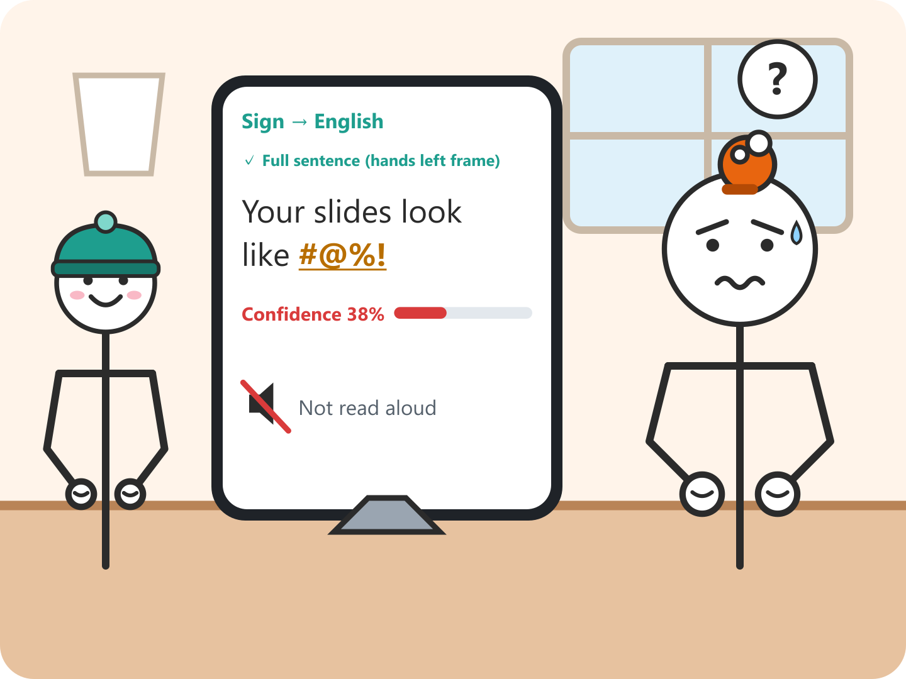
B2 · Mistranslation: reader's view
Reader: Sam, a non-signing classmate who reads the captions (stakeholder map #2) Setting: Same café, the same mistranslation as B1
1
Panel 1 of 4
See an insult
Sam reads “Your slides look like #@%!” at 38% confidence, and it is not read aloud.
S5 / G10
G10: Scope when in doubt
Datasheet gap How2Sign, our training set, is ~80 h of instructional ASL from 11 signers, filmed front-on in a studio. Casual and regional sign variants are rare, so an out-of-vocabulary (OOV) sign is mapped to the closest sign the model knows. Webcam conditions also differ from the studio (stakeholder map #1).
Notes:
Panel 1: Sam reads “Your slides look like #@%!” at 38% confidence, and it is not read aloud. Storyboard B2, reader Sam. This is the B1 error from the other side, and here the stakes are the relationship. Stage 5 (panels 1 and 2): the Unsure flag and the 'Why unsure?' explanation (G10, G11) give Sam a reason to doubt the insult. Sam acts on the output in panel 2 by asking instead of taking offense. Stage 4 (panels 3 and 4): Sam does not fix anything. Recovery for Sam means seeing the caption replaced (G8) and the correction labeled as typed (G9). Same error, different recovery: Jordan corrects, Sam re-interprets.

Slide 19
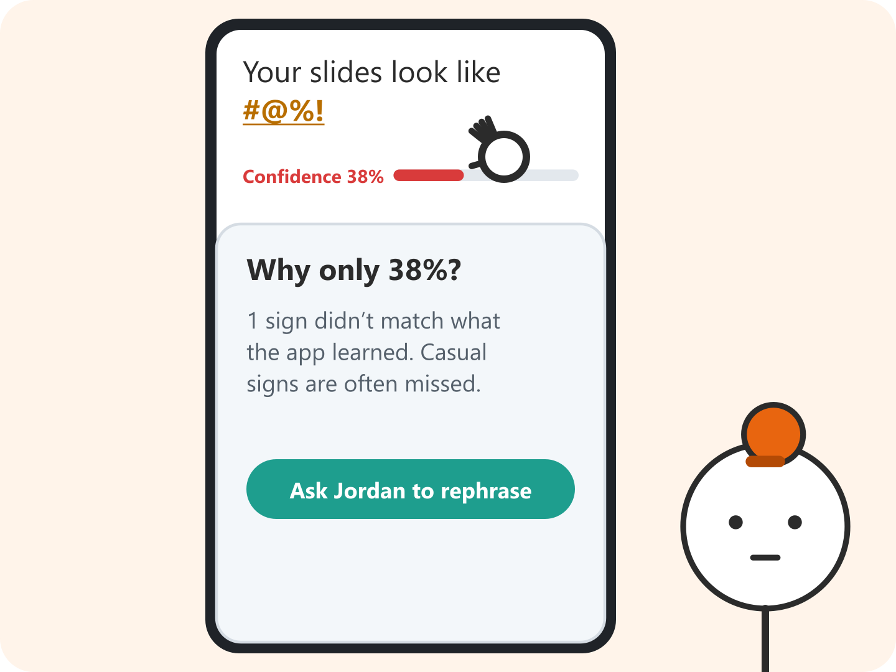
B2 · Mistranslation: reader's view
Reader: Sam, a non-signing classmate who reads the captions (stakeholder map #2) Setting: Same café, the same mistranslation as B1
2
Panel 2 of 4
Ask why
Sam taps the underlined word: it is only 38% because one sign was not recognized, so the app suggests asking Jordan to rephrase.
S5 / G11
Acts on output
G11: Explain why
Notes:
Panel 2: Sam taps the underlined word: it is only 38% because one sign was not recognized, so the app suggests asking Jordan to rephrase. Storyboard B2, reader Sam. This is the B1 error from the other side, and here the stakes are the relationship. Stage 5 (panels 1 and 2): the Unsure flag and the 'Why unsure?' explanation (G10, G11) give Sam a reason to doubt the insult. Sam acts on the output in panel 2 by asking instead of taking offense. Stage 4 (panels 3 and 4): Sam does not fix anything. Recovery for Sam means seeing the caption replaced (G8) and the correction labeled as typed (G9). Same error, different recovery: Jordan corrects, Sam re-interprets.

Slide 20
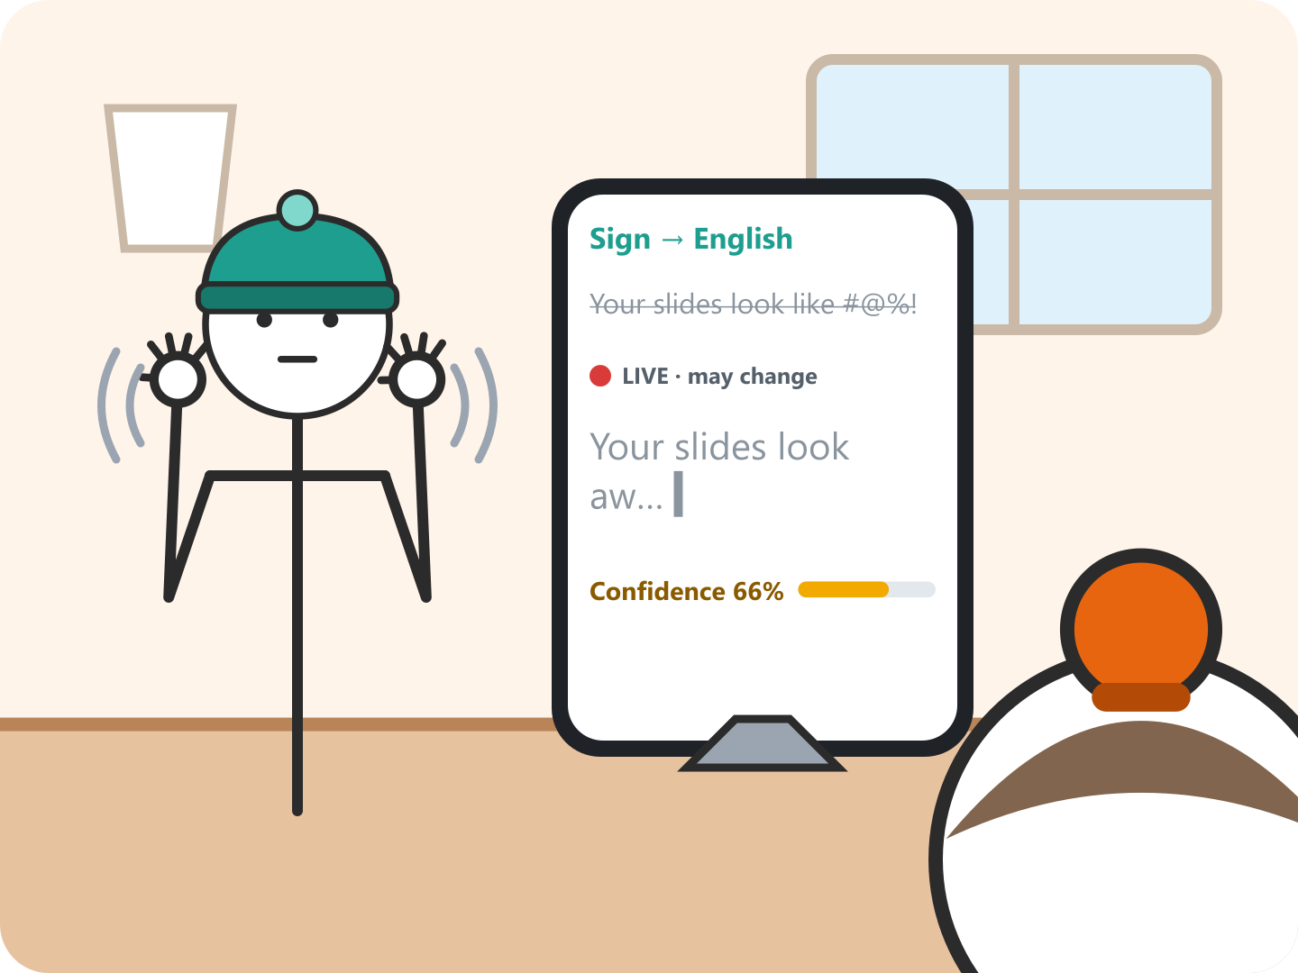
B2 · Mistranslation: reader's view
Reader: Sam, a non-signing classmate who reads the captions (stakeholder map #2) Setting: Same café, the same mistranslation as B1
3
Panel 3 of 4
See it replaced
Jordan re-signs. The flagged caption is struck out and new gray words stream in at 66%, so Sam knows it was the app's error.
S4 / G8
G8: Efficient dismissal
Notes:
Panel 3: Jordan re-signs. The flagged caption is struck out and new gray words stream in at 66%, so Sam knows it was the app's error. Storyboard B2, reader Sam. This is the B1 error from the other side, and here the stakes are the relationship. Stage 5 (panels 1 and 2): the Unsure flag and the 'Why unsure?' explanation (G10, G11) give Sam a reason to doubt the insult. Sam acts on the output in panel 2 by asking instead of taking offense. Stage 4 (panels 3 and 4): Sam does not fix anything. Recovery for Sam means seeing the caption replaced (G8) and the correction labeled as typed (G9). Same error, different recovery: Jordan corrects, Sam re-interprets.

Slide 21
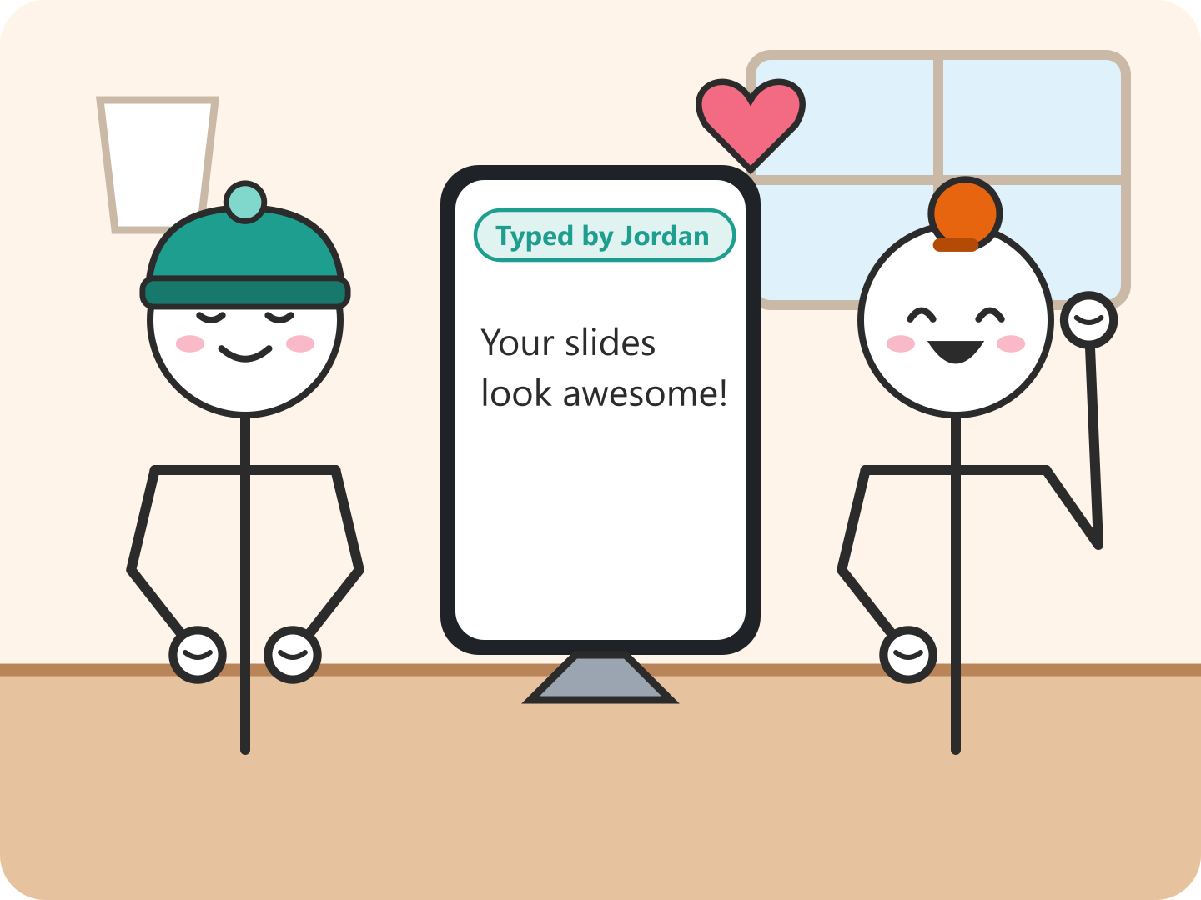
B2 · Mistranslation: reader's view
Reader: Sam, a non-signing classmate who reads the captions (stakeholder map #2) Setting: Same café, the same mistranslation as B1
4
Panel 4 of 4
Get the real message
Jordan's correction arrives marked “Typed by Jordan”, and Sam laughs it off.
S4 / G9
G9: Efficient correction
Notes:
Panel 4: Jordan's correction arrives marked “Typed by Jordan”, and Sam laughs it off. Storyboard B2, reader Sam. This is the B1 error from the other side, and here the stakes are the relationship. Stage 5 (panels 1 and 2): the Unsure flag and the 'Why unsure?' explanation (G10, G11) give Sam a reason to doubt the insult. Sam acts on the output in panel 2 by asking instead of taking offense. Stage 4 (panels 3 and 4): Sam does not fix anything. Recovery for Sam means seeing the caption replaced (G8) and the correction labeled as typed (G9). Same error, different recovery: Jordan corrects, Sam re-interprets.

Slide 22
Guideline Trade-offs
G2 vs. over-trust
A 91% bar helps Sam act fast, but a high score on a wrong caption gets believed more. So the bar is color-coded and nothing below 75% is read aloud.
G10 vs. G3 (flow)
Holding back audio when unsure keeps a swear from being said aloud, but it slows the conversation and makes Jordan re-sign.
G3 (hands out of frame) vs. false triggers
Ending a sentence when both hands leave the frame needs no extra gesture, but a hand dropping mid-sentence, or a bystander's hand (map #6), can cut a sentence short. So the app waits a beat before translating.
G15 vs. privacy
Saving failed phrases would fix OOV signs over time, but it conflicts with keeping no video. So it is opt-in, uses pose points and text only, and is reviewed offline (Level 1).
Notes:
The rubric asks us to explain trade-offs between guidelines. Each card is a choice our storyboards made and what it costs.

Slide 23
What We Changed After the Stranger Test
After the Week 5 stranger test, we changed:
A1: words now stream in live with a 0–100% confidence bar under every caption, and the whole sentence is re-translated when both hands leave the frame. The X undo pose became re-signing the sentence.
B1: named the cause (an OOV casual sign, a How2Sign gap), added an explicit doubt panel (G10/G11), and made saving a failed phrase opt-in with no video.
A2 and B2 (new): split the single storyboard into signer and reader versions, so the same error shows a different recovery for each person.
All: redrew each panel from the phone camera's view of the signer's face, hands and body, with the pose points the model actually sees.

